Slide 1
FEDERATED LEARNING IN GAZE RECOGNITION (FLIGR)
MASTER THESIS DEFENSE
May 21, 2021
COMMITTEE MEMBERS:
Dr. Jacob Furst
Dr. Daniela Raicu
Dr. Ilyas Ustun
PRESENTED BY:
Arun Gopal Govindaswamy
THANKS TO:
Medical Informatics (MEDIX) Lab

Slide 2
TABLE OF CONTENTS
1
2
3
4
INTRODUCTION
DATA
METHODS
RESULTS
5
CONTRIBUTIONS
Collaborative Learning
Federated Learning
Gaze Recognition
Data Preparation
Data Processing
Data Management
Local Models
Global Models
Fine-Tuned Models
Analysis
Discussions
Conclusion
Contributions
Future Work

Slide 3
INTRODUCTION

Slide 4
MAIN CONCEPTS
FEDERATED LEARNING
GAZE RECOGNITION
A collaborative learning technique
Identifying where the doctor is looking at

Slide 5
MACHINE LEARNING
Fast growing field
Success and failure -> Data
Machine Learning models thrive on data
ML models finds patterns in the data
More data -> Better ML models

Slide 6
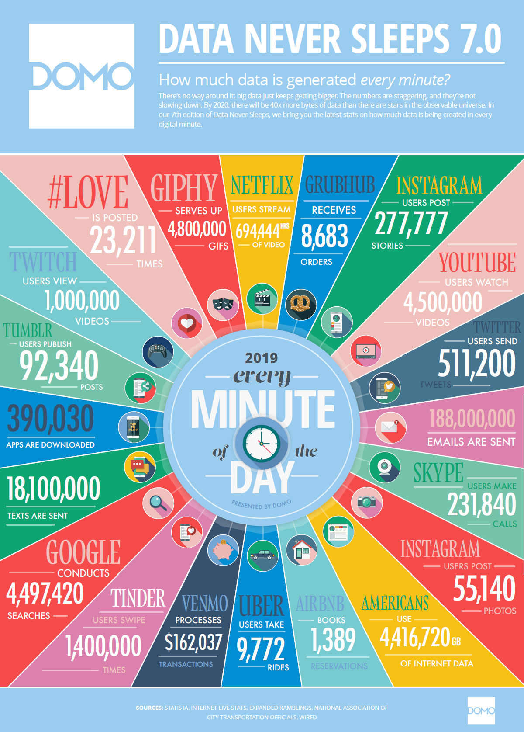
BIG DATA
Huge amount of data available globally
Data is collected and stored locally
Notes:
https://www.visualcapitalist.com/big-data-keeps-getting-bigger/

Slide 7
DATA DISPARITY
Institution A
USA
1000 CT Scan Images
Data Processing
Model Building
Research Findings
Institution B
India
50 CT Scan Images
Data Processing
Model Building
Research Findings
Institution C
China
5000 CT Scan Images
Data Processing
Model Building
Research Findings
Institution D
South Africa
10 CT Scan Images
Data Processing
Model Building
Research Findings

Slide 8
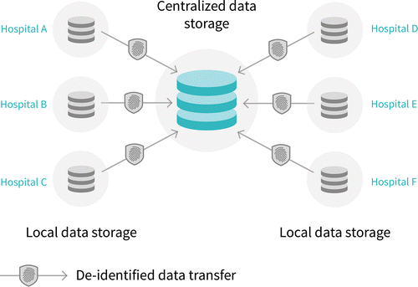
Data Collaboration
Enables access to data available globally
Notes:
Reference: Preparing Medical Imaging Data for Machine Learning, Martin J. Willemink, Wojciech A. Koszek, Cailin Hardell, Jie Wu, Dominik Fleischmann, Hugh Harvey, Les R. Folio, Ronald M. Summers, Daniel L. Rubin, and Matthew P. Lungren Radiology 2020 295:1, 4-15

Slide 9
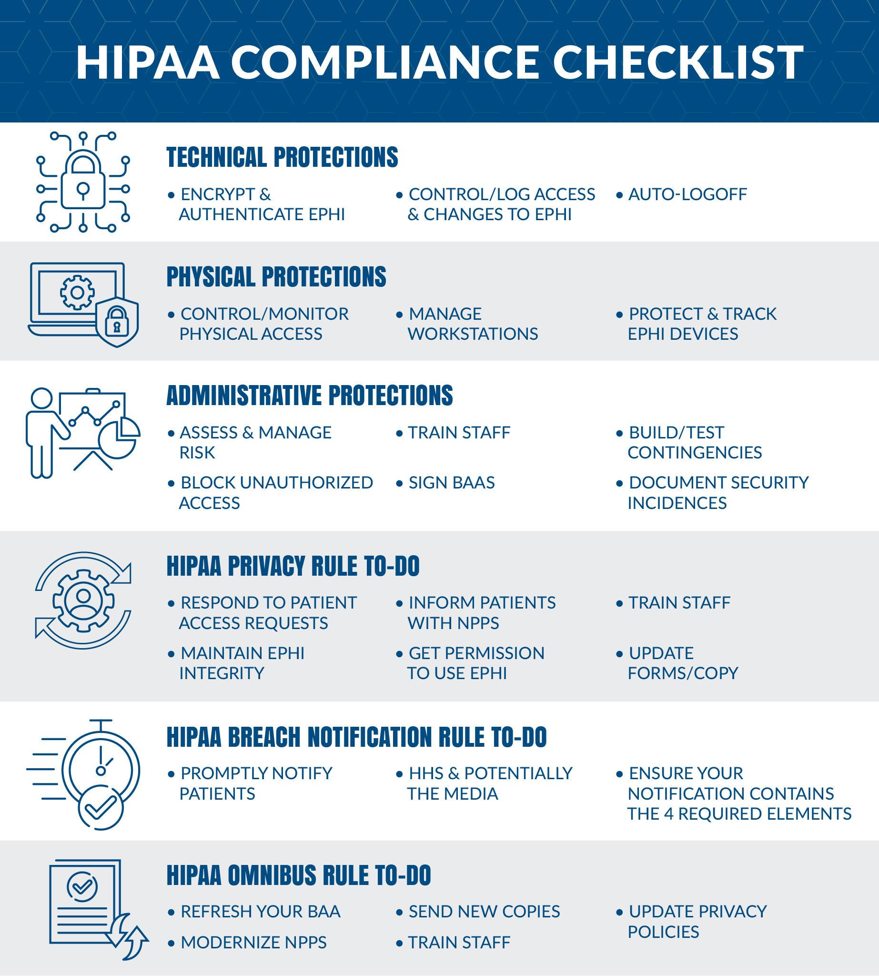
DATA SECURITY
Data collection, storing, sharing and usage are regulated
Example:
USA – HIPAA Act
Data sharing is not easy, and it is time consuming
Notes:
https://www.atlantic.net/hipaa-compliant-hosting/hipaa-compliance-guide-what-is-hipaa/

Slide 10
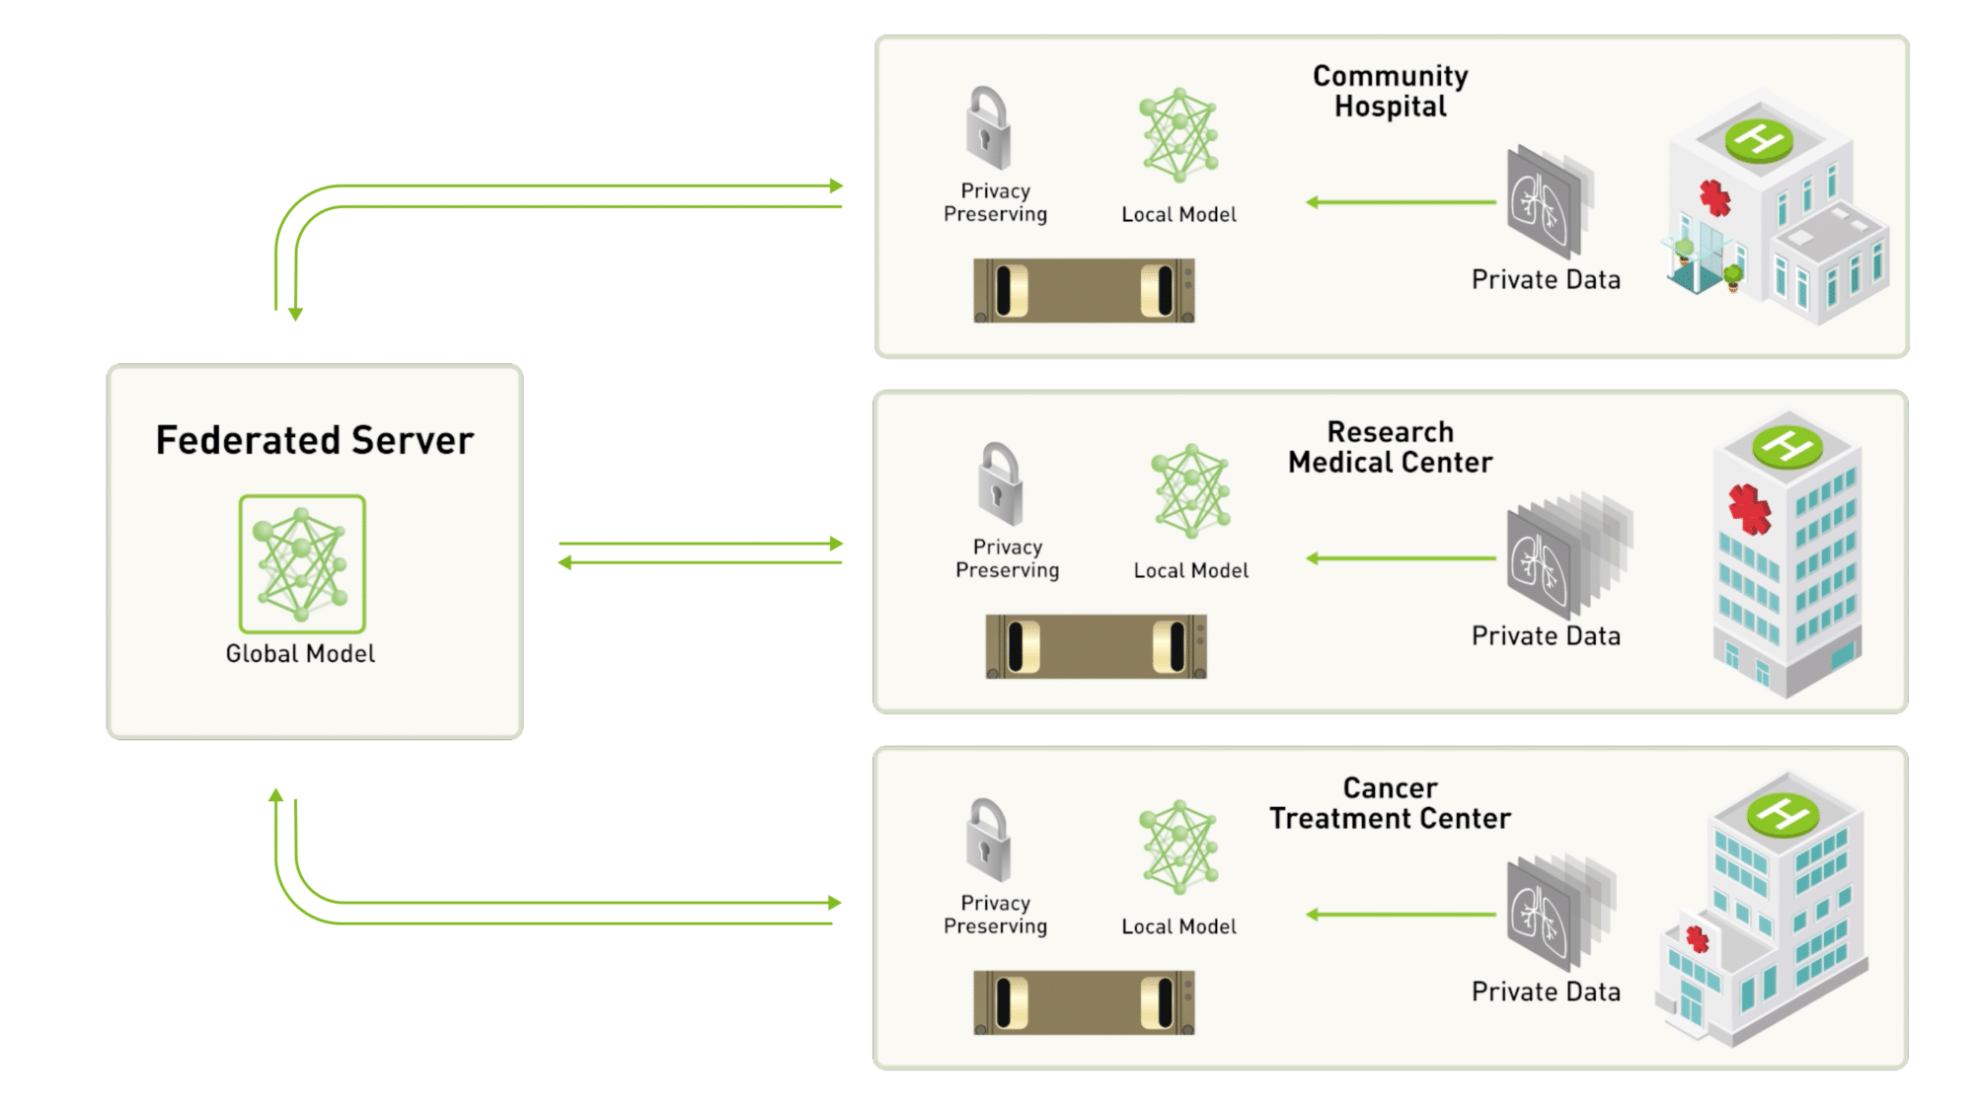
FEDERATED LEARNING
Local institutions have local data
Institutions build local models
Share models between them
Create global model
Repeat
Notes:
https://blogs.nvidia.com/blog/2019/10/13/what-is-federated-learning/

Slide 11
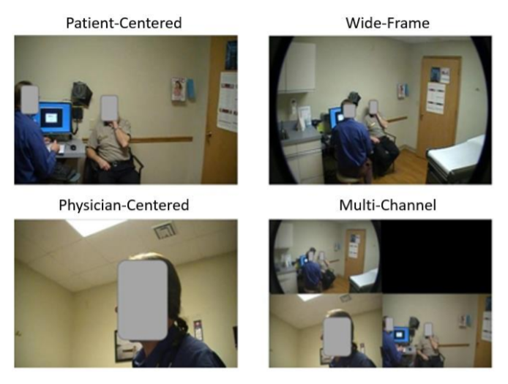
GAZE RECOGNITION
Identifying where the doctor is looking at.
Where is the doctor’s gaze is at?
At the patient
Somewhere else
Challenges:
Highly distributed data across doctors

Slide 12
Why is gaze recognition important?
Advancements in healthcare technology
To understand how much time the doctor is spending on the patient.
To directly relate patient’s satisfaction with doctor’s behavior.
To overall understand the impact of health care technology on patient satisfaction

Slide 13
DATA

Slide 14
DATA
Recorded video interactions
10 doctors – 101 patients
Three different camera
Multi-channel videos
29.97 frames per second

Slide 15
DATA DISTRIBUTION
Data comes from a single study
101 interactions with 10 different doctors
5 different clinics
10 different clinical room
Each doctor data is considered as a separate institution
Manual video analysis to select data
6 minute of data from each interaction

Slide 16
DATA
Institution | Training Data | Validation Data
1 | 3, 4, 6, 7, 35, 36 | 37
2 | 17, 26, 27, 28, 29, 31 | 40
3 | 9, 12, 13, 14, 15, 16 | 19
4 | 22, 23, 42, 43, 51, 52 | 54
5 | 32, 33, 34, 48, 49, 50 | 80
6 | 38, 46, 47, 55, 56, 57 | 58
7 | 60, 63, 64, 65, 68, 72 | 75
8 | 77, 78, 79, 84, 98, 100 | 101
9 | None | 1, 2, 59, 66, 67, 73, 74

Slide 17
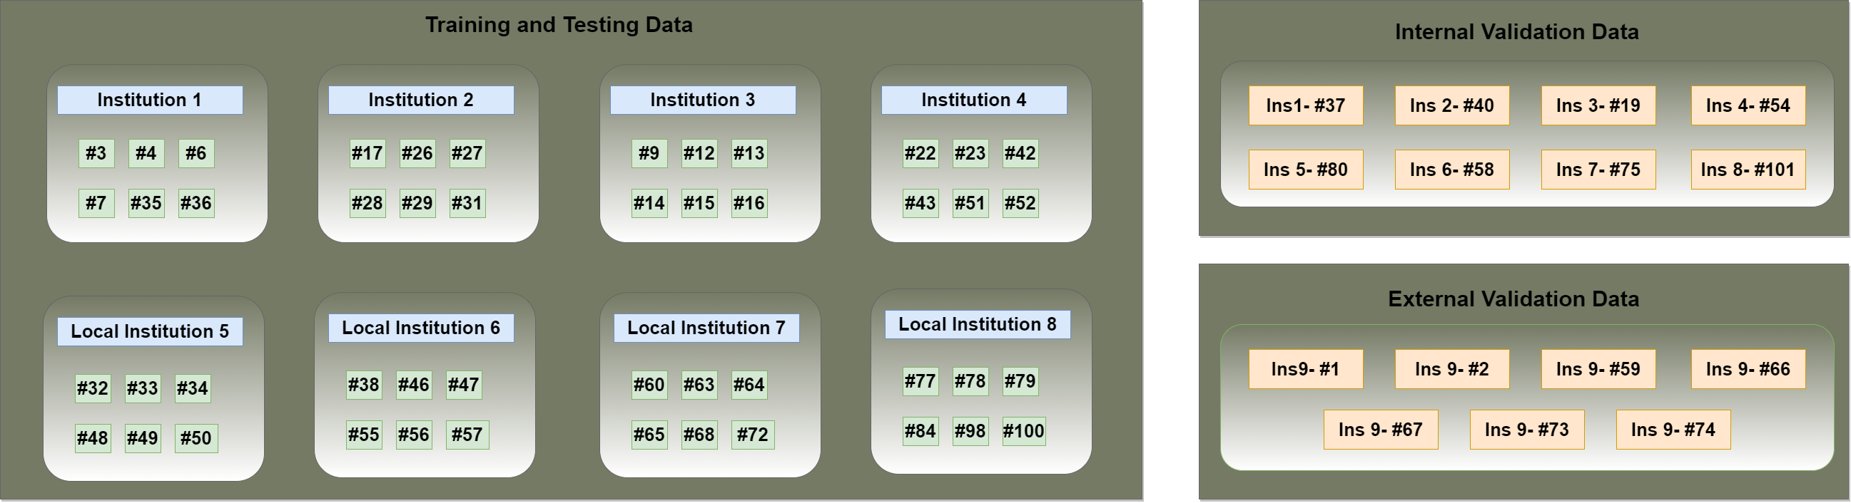
DATA SPLIT

Slide 18
METHODOLOGY
Local Models
Global Model
Fine-tuned Model

Slide 19
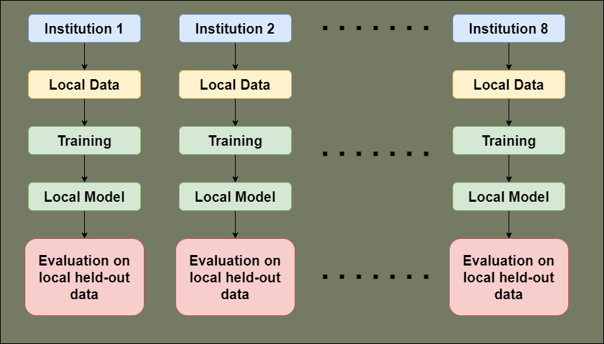
LOCAL MODELS
8 different local models trained on local institutional data
Each institution has a held-out interaction used for validation purposes
8 models have same architecture where only the number of training iterations differ
Optimizer - Adam, Batch Size = 32

Slide 20
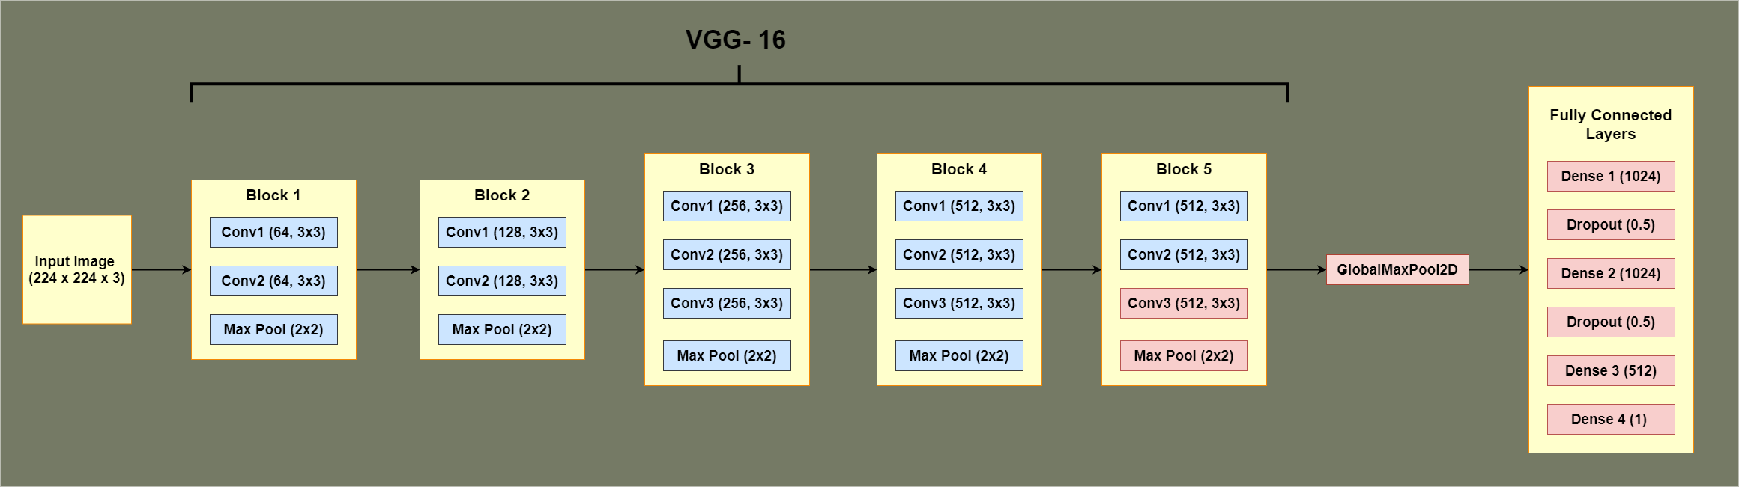
CNN ARCHITECTURE

Slide 21
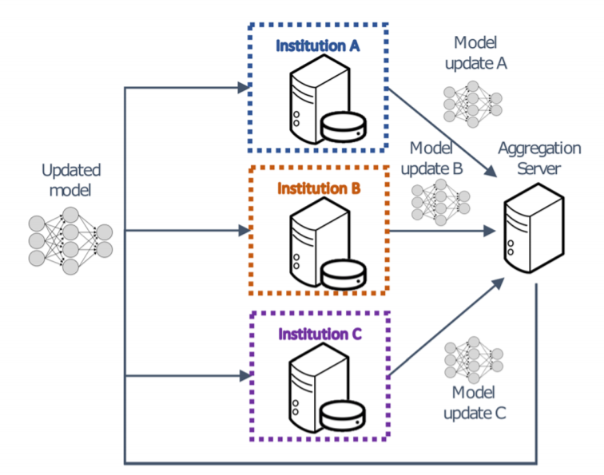
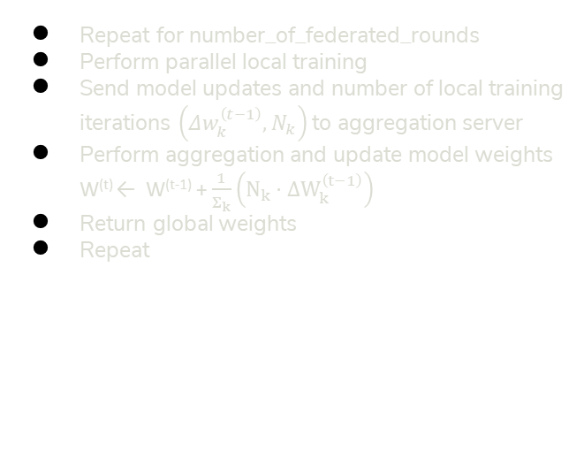
GLOBAL MODELS
Repeat for number_of_federated_rounds
Perform parallel local training
Send model updates and number of local training iterations $\left(Δw_{k}^{\left(t−1\right)},N_{k}\right)$to aggregation server
Perform aggregation and update model weights W^{(t)} ← W^{(t-1)} + $\frac{1}{Σ_{k}}\left(N_{k}⋅ΔW_{k}^{\left(t−1\right)}\right)$
Return global weights
Repeat

Slide 22
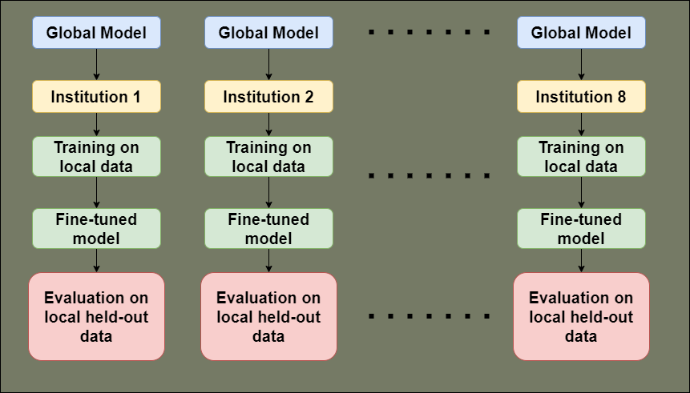
FINE-TUNED MODELS
Global model at the end of federated learning is shared to local institutions
Local institutions train the global model with local data one last time
This fine-tunes the global model to fit the local data

Slide 23
RESULTS

Slide 24
MODEL COMPARISONS

Slide 25
GLOBAL MODEL PERFORMANCE

Slide 26
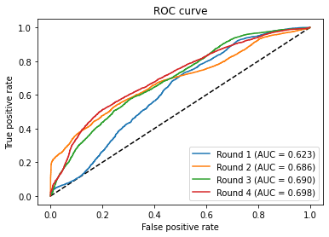
GLOBAL MODEL PERFORMANCE

Slide 27
GLOBAL MODEL PERFORMANCE

Slide 28
GLOBAL MODEL PERFORMANCE

Slide 29
CONCLUSION
Advantages of Federated Learning
Enables use of global data
Solves issues with conventional data sharing methods
Enables data diversity
Produces robust AI models

Slide 30
CONTRIBUTIONS

Slide 31
CONTRIBUTIONS
Empirical study of federated learning in the application of gaze recognition
Introduction of fine-tuned models within federated learning approach

Slide 32
REFERENCES
Slide 6 - https://www.visualcapitalist.com/big-data-keeps-getting-bigger/
Slide 8 - Preparing Medical Imaging Data for Machine Learning, Martin J. Willemink, Wojciech A. Koszek, Cailin Hardell, Jie Wu, Dominik Fleischmann, Hugh Harvey, Les R. Folio, Ronald M. Summers, Daniel L. Rubin, and Matthew P. Lungren Radiology 2020 295:1, 4-15
Slide 9 - https://www.atlantic.net/hipaa-compliant-hosting/hipaa-compliance-guide-what-is-hipaa/
Slide 10 - https://blogs.nvidia.com/blog/2019/10/13/what-is-federated-learning/

Slide 33
Thank You
Any Questions?

Slide 34
BANG!
Contact: agovind2@depaul.edu

Slide 35
Instructions for use (free users)
In order to use this template, you must credit Slidesgo by keeping the Thanks slide.
You are allowed to:
Modify this template.
Use it for both personal and commercial purposes.
You are not allowed to:
Sublicense, sell or rent any of Slidesgo Content (or a modified version of Slidesgo Content).
Distribute this Slidesgo Template (or a modified version of this Slidesgo Template) or include it in a database or in any other product or service that offers downloadable images, icons or presentations that may be subject to distribution or resale.
Use any of the elements that are part of this Slidesgo Template in an isolated and separated way from this Template.
Delete the “Thanks” or “Credits” slide.
Register any of the elements that are part of this template as a trademark or logo, or register it as a work in an intellectual property registry or similar.
For more information about editing slides, please read our FAQs or visit Slidesgo School:
https://slidesgo.com/faqs and https://slidesgo.com/slidesgo-school

